Slide 1
Review of my Second Pathways:
Motivational Strategy

Slide 2
my accomplishments in Toastmasters
my accomplishments outside of Toastmasters
the impact of being a Toastmasters
next steps

Slide 3
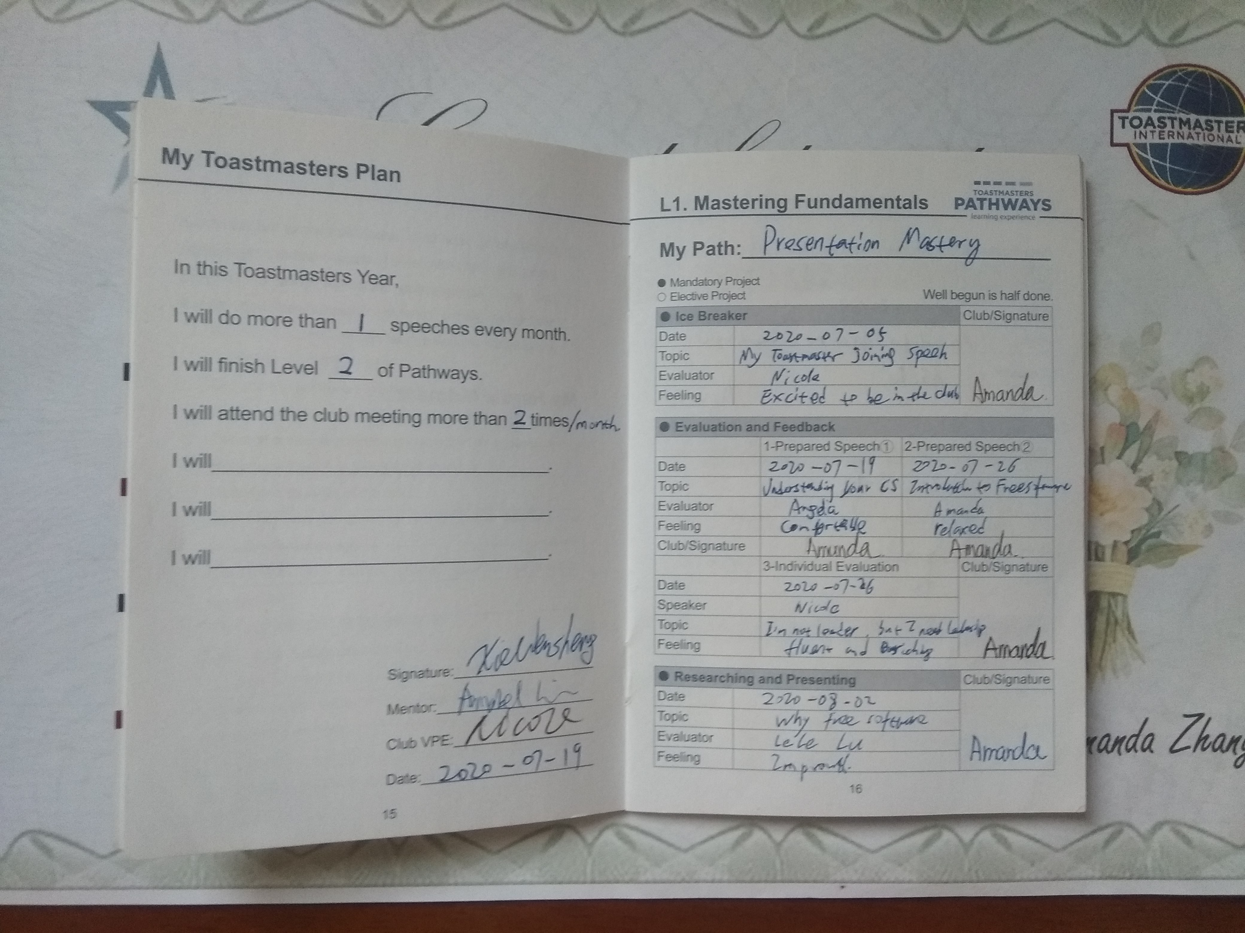
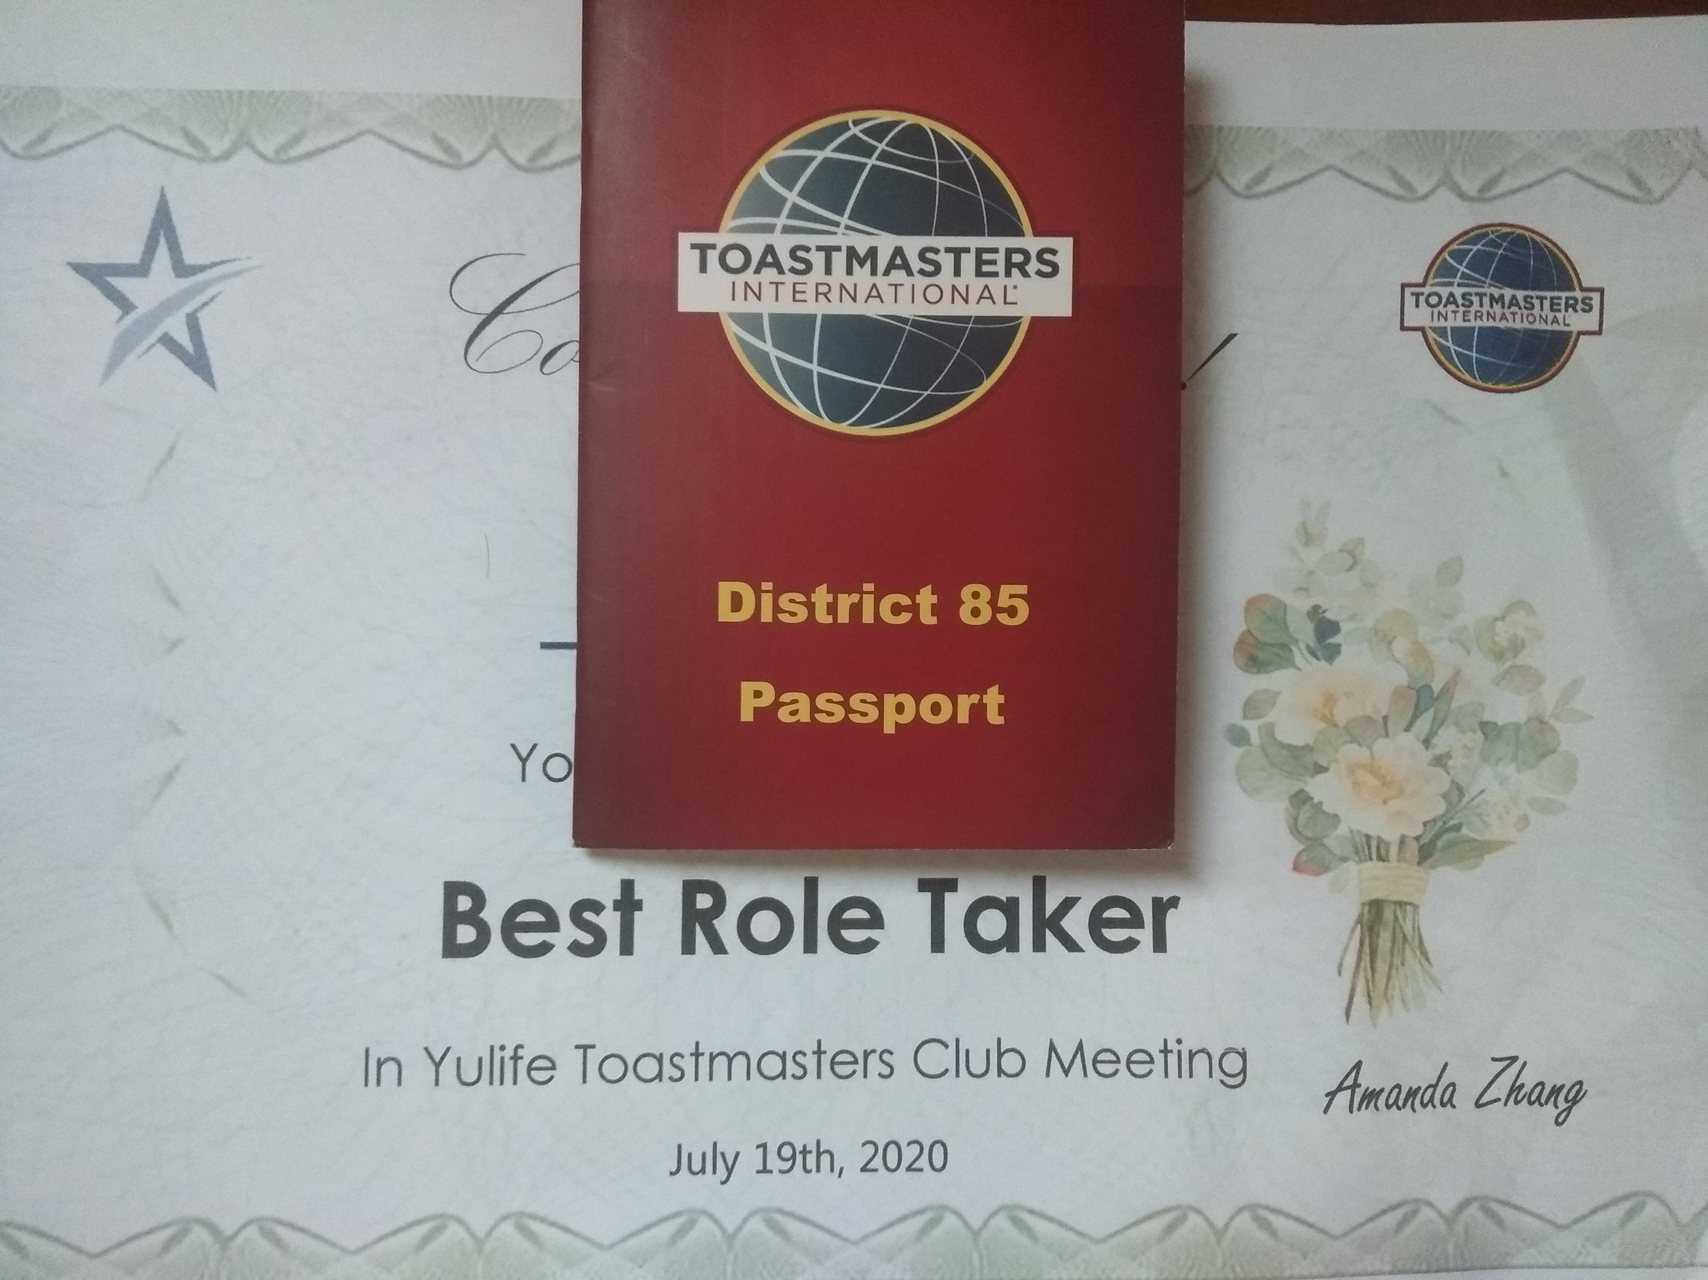
accomplishments in Toastmasters

Slide 4
accomplishments in Toastmasters
level 1
project 1
Ice Breaker: Bold
project 2
Evaluation and Feedback
project 3
Research and Present
level 2
project 1
Understand Your Communication Style: Be Nice
project 2
Active Listening
project 3
Introduction to Toastmasters Mentor

Slide 5
level 3
project 1
Understanding Emotional Intelligence: Some Emotional Moments
project 2
Inspire Your Audience: Keep our club healthy
project 3
Effective Body Language:
level 4
project 1
Motivate Others: Pull the Trigger
project 2
Question and Answer Session: Copyright - past, present, future
level 5
project 1
Team Building: Is project management against human nature?
project 2
Prepare to Speak Professionally: Member Rewards Program

Slide 6
accomplishments outside of Toastmasters
Habit
Life & Work

Slide 7
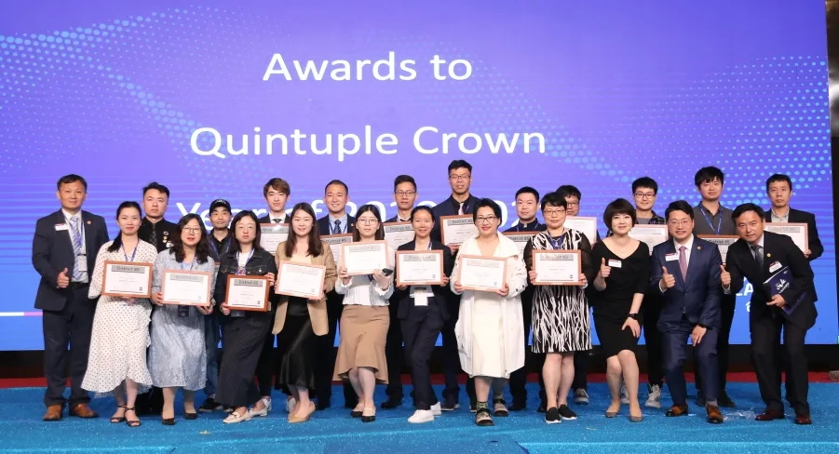
impact of being a Toastmasters

Slide 8
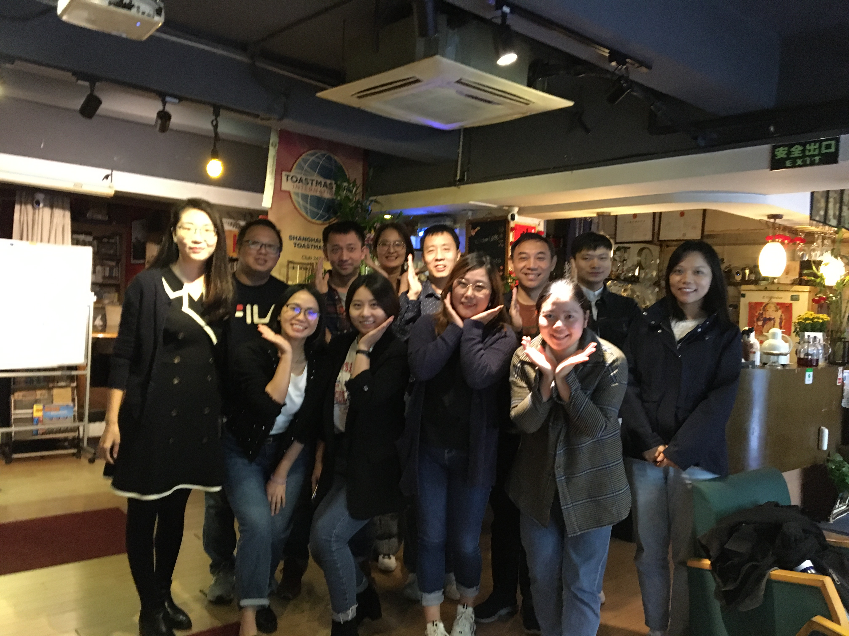
Next Steps

Slide 9
Thanksgiving
Toastmasters
Clubs
Mentors
IEs
All of You

